Slide 1

Bank Analytics
By : Nitesh yadav

Slide 2
Introduction to Bank Analytics
Bank Loan Analysis Dashboard is designed to provide a visual and analytical breakdown of critical loan data. Each dashboard focuses on various aspects of loan management, including total loan amounts, revolving balances, and customer insights. They display key metrics like loan status (charged off, fully paid, current), home ownership types, and state-wise and year-wise distributions. The dashboards also offer a detailed view of loan grades, sub-grades, and payment verifications, providing valuable insights into loan performance, risk management, and regional trends.

Slide 3
Purpose of Project - Bank Analytics
The purpose of this dashboard is to provide an intuitive and visual representation of the bank's loan portfolio to help decision-makers:
Evaluate Lending Performance: Review how the bank’s lending practices perform over time and identify areas for improvement. Make Data-Driven Decisions: Leverage insights from loan verification status, sub-grades, and default rates to make informed decisions on lending policies.
Strategize for Risk Mitigation: Use geographic, sub-grade, and loan default data to refine risk management strategies and minimize losses from defaults.
Enhance Customer Focus: Identify customer preferences for loan purposes and home ownership categories to tailor future offerings and enhance customer satisfaction.
This dashboard serves as a strategic tool to monitor the bank's lending portfolio, improve risk management, and align with market trends.

Slide 4
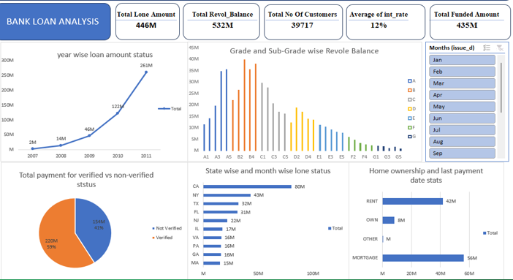
Excel Dashboard

Slide 5
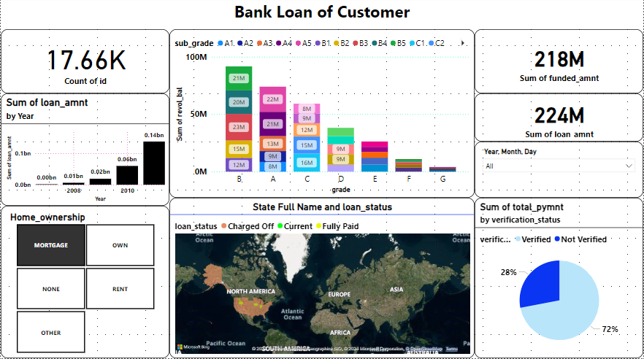
Power-BI Dashboard

Slide 6
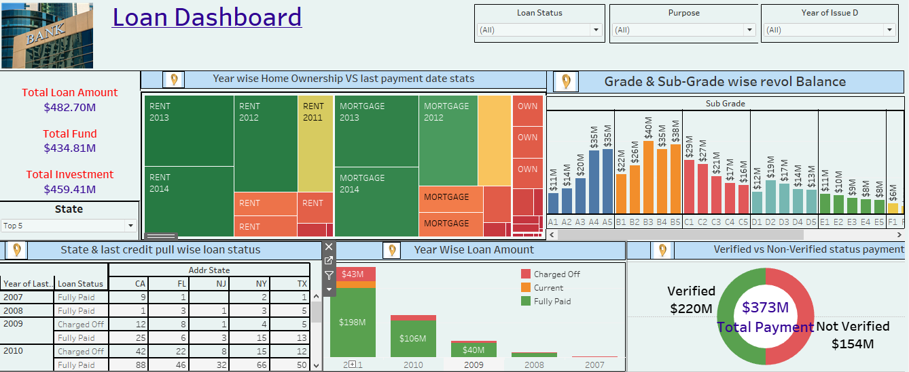
Tableau Dashboard

Slide 7
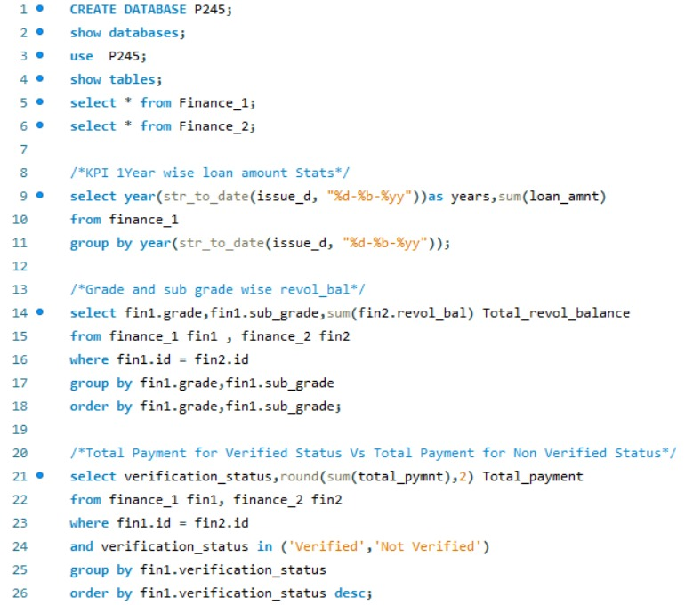
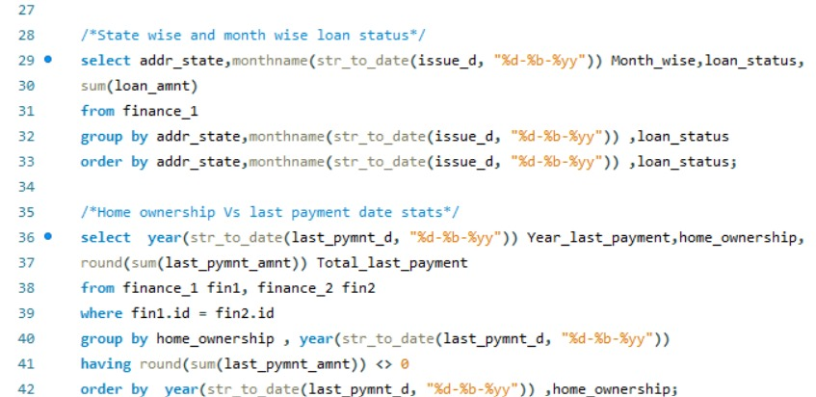
SQL Queries

Slide 8
Objective of Dashboard
The primary objective of this dashboard is to provide a comprehensive analysis of the bank's loan portfolio. It helps stakeholders understand key loan trends, customer preferences, and financial performance metrics. The dashboard facilitates:
Analyzing Loan Distributions: Showcasing loan amounts by year, type, purpose, and home ownership .
Identifying Risk Factors: Highlighting loan defaults, verification status, and sub-grade performance to assess risk exposure.
Monitoring Performance: Offering insights into completion rates, geographic trends, and monthly loan application patterns to track overall bank lending activity

Slide 9
Dashboard Explanation
🏦 Loan Overview: Our report analyzes over 40K loan applications, with a total funded amount of 435M and total payment of 482.7M.
🔍 Verification Status: 22.64% of loan amounts are verified through different sources, showing the significance of thorough verification processes.
🏡 Home Ownership and Loan Amount: Mortgages constitute the highest loan amount (224M), compared to rentals (189M), indicating a preference for real estate-related loans.
📅 Loan Applications by Year: Loan amounts peaked at 104M in 2012, with notable fluctuations across years.
📊 Loan Purpose Trends: Debt consolidation stands as the most common purpose (18.6K applications), followed by credit card and home improvement loans.
📈 Loan Completion: The completion rate is 85.83%, showcasing the bank's success in lending responsibly.
⚠️ Loan Defaults: The default rate is 14.17%, with 6K defaulters and a total defaulted funded amount of 66M.
🌍 Geographic Insights: Most loan applications originate from specific states, with visual representation highlighting hotspots across the country.

Slide 10
📊 Monthly Trends: Applications decrease gradually over the year, with the highest numbers seen in early months like January and February.
Sub-grade Analysis: Detailed analysis of loan sub-grades shows significant trends in loan amounts and funded balances for grades “A to D”
These insights help provide a clear picture of lending trends, customer preferences, and default risks.

Slide 11
Conclusion of Bank Analysis
The insights derived from the dashboard demonstrate clear trends in the bank’s loan operations:
High Loan Demand for Real Estate and Debt Consolidation: Mortgage loans and debt consolidation dominate the loan distribution, indicating customer preferences.
Steady Completion Rates: With a completion rate of 85.83%, the bank's responsible lending practices are evident.
Risk from Defaults: The 14.17% default rate represents a notable risk factor, especially with 66M defaulted loans, signaling the need for better risk management strategies.
Yearly Fluctuations and Monthly Trends: Loan applications vary significantly over the years, peaking in 2012, and show seasonal decreases throughout the year, which may require targeted marketing efforts during low-application months.

